Slide 1


Sustainability Reporting: Current Trend and Future Scope
April, 2016
Santanu Roy
General Manager (Corporate Planning)
GAIL (India) Limited

Slide 2


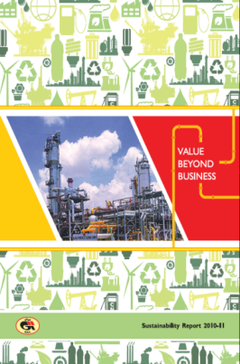
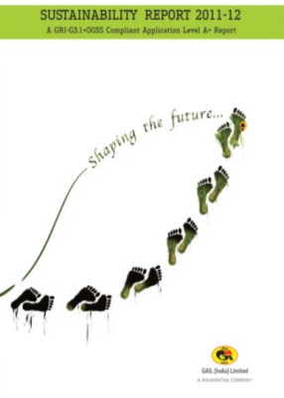


Sustainability Reporting (SR) @ GAIL
A multi stakeholder and
independent institution whose mission is to develop and disseminate globally applicable Sustainability Reporting Guidelines
2000
2002
2006
2011
2013
G1
G2
G3
G3.1
G4
2012
2013
2013
2014
2015
SR FY 10-11
SR FY 11-12
SR FY 12-13
SR FY 13-14
SR FY 14-15
Value Beyond Business
Shaping the Future
Energising Tomorrow Responsibly
Issued with AR
Care, Share & Grow
Aligned with AR
Fostering Responsible Growth
Aligned with AR
(G3, B+) → (G3.1, A+) → (G3.1, A+) → (G3.1, A+) → (G4 Core)

Slide 3
GAIL’ Experience: SR as a mgmt Tool
While we anyway fulfill our mandatory requirement of reporting in letter…
we stretch to go beyond for mainstreaming sustainability in true spirit.
Availability of Company wide database: Data Management- e-Sustainability Module
A step towards Mainstreaming: SD Aspirations 2020
Institutionalizing Sustainability: Robust Governance
Sensitization
Policy Development
Stakeholder Engagement
Robust Materiality Process: More logical approach followed
Sustainability Reporting serves dual purpose:
Disclosure in public domain
Tool for Management to manage sustainability
GAIL is proactively taking actions and going beyond mandatory to truly integrate sustainability within the organization.

Slide 4
GAIL’ Experience: SR as a mgmt Tool
Data Management
Data Monitoring
Three Level Authorization
Data Capture
a. Every level can monitor & compare data through online report
b. Separate Report for ED level to facilitate approval process.
Ensures:
Accountability
Transparency
Data Control
Data Trail
Timeliness
Cost Saving
Customization
Three level of authorization
Entry
Forward (HOD/OIC)
Approval (ED)
Data capturing provision: Monthly/Quarterly/ Annual
Alert for variation of more than 10 %
Help provision for data definition assistance.
The Module developed “in-house” has enabled us to align our Sustainability Reporting cycle with our Annual Report

Slide 5
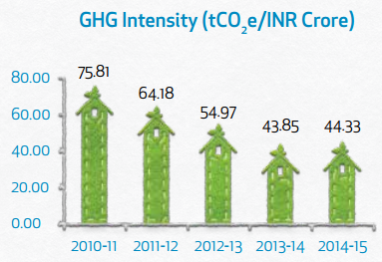
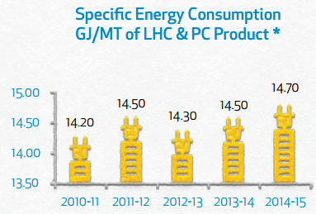
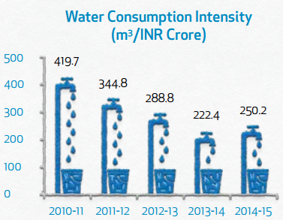
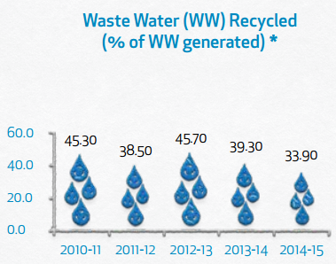
GAIL’ Experience: SR as a mgmt Tool
Sustainability Aspirations 2020
Target: 50.8 (tCO2e/Cr)
Target: 13.30 GJ/MT
Target: 230.86 m3/Cr
Target: 45%
Reduction of 5% (upto 2020)- Specific Energy, Specific GHG Emission
Reduction of 15% (upto 2020)- Specific Fresh Water Consumption

Slide 6
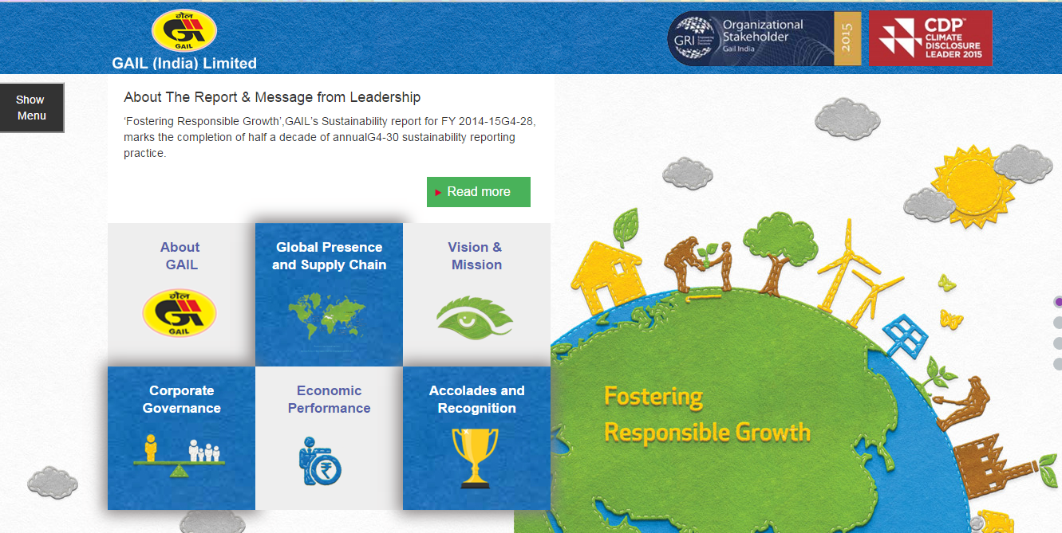
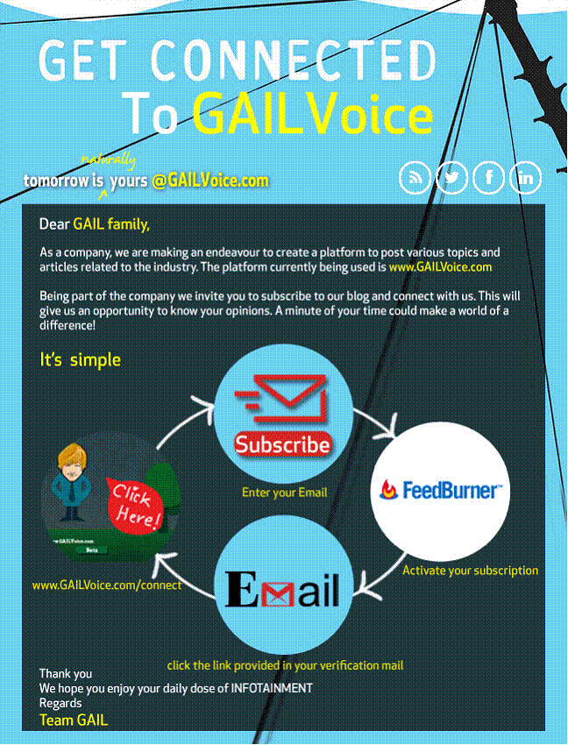
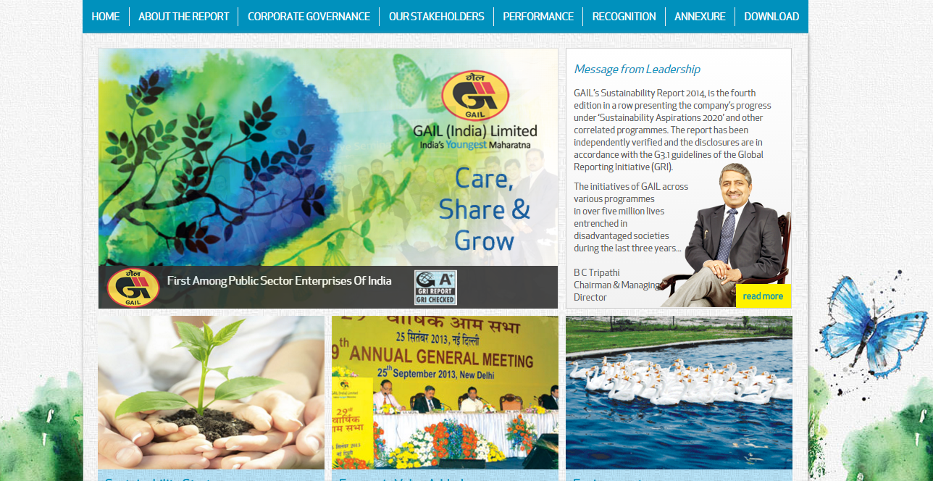
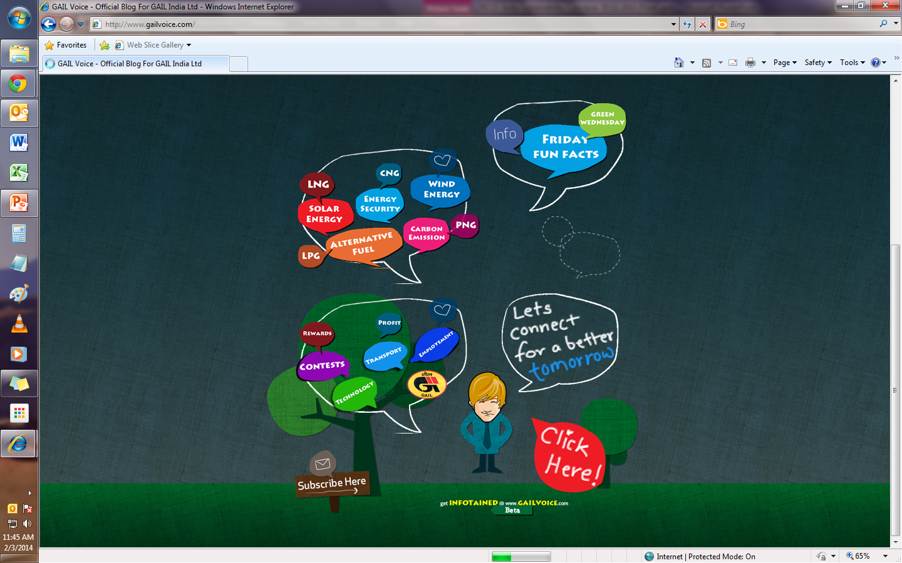
GAIL’ Experience: SR as a mgmt Tool
Improved communication
GAIL Voice-
Communication channel enables stakeholders to connect through various social platforms

Slide 7
Disclaimer
Disclaimer: The views expressed here are solely those of the presenter in his private capacity and do not in any way represent the views of the Organization.

Slide 8
Harnessing the key drivers of Change
Organizations need to make a strategic shift to derive more out of the reporting exercise.
Strategic alignment between sustainability and commercial decisions has become a business imperative.
Expanding the scope and significance of issues across the value chains.
Proliferation of sustainability-related standards, rankings, ratings and indices.
Digital innovation offer new ways of presenting data and communicating with audiences.
Economic
Social
Env.
HOW … ??
C
I
OLLABORATION
OMPETITIVE ADVANTAGE
OMMITMENT
NNOVATE
NTEGRATE
NCLUSIVE GROWTH
Successful organizations adapt to a continually changing market, whether
these changes are economic, social or environmental and capitalize on the shifting context in which business is done through innovation.

Slide 9
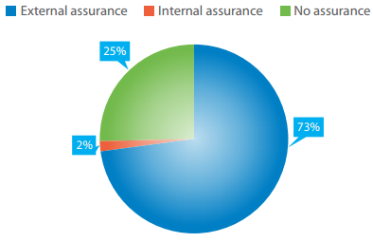
Current Trends
1
Reports lack info on whether every significant impact has been taken into account, 69% of the companies take into account impacts within organization. Only half of the companies take into account the impacts outside the organization.
82% of the companies address materiality in their reports, however, only a limited no. of companies have shown any evidence of applying a structured process to define materiality.
2
3
43% of the companies provide information on ERM. Only a quarter of them incorporate Environmental, Social and Governance (ESG) factors.
Only 59% of the top 100 and 54% of the non-top 100 companies’ statements refer to the broader trends affecting the company and influencing sustainability priorities
4
REPORT versus REPORTING ??
Source: Moving Beyond Disclosure: Leveraging Sustainability Reporting to Drive Change,
A Study by GRI Focal Point India & TCS

Slide 10
Points of Contention
Sustainability reports address a diverse audience, which includes investors, consumers, employees, civil society, government agencies, NGOs, rating agencies, and others. Is stakeholder centric approach considered?
1
2
Platforms to share thoughts- Naming or Shaming the reporters
3
Going beyond the organization- considering ESG impacts on value chain
4
Integration of the 3P- Profit, Planet, People in true sense. Making business sense of sustainability. Greater alignment to business needed
5
Plethora of guidelines- region specific and sector specific industry voice to tackle common issues
6
Mere branding annual ritual- independent sporadic efforts lacking macro direction
7
Effectiveness of the mode of communication

Slide 11
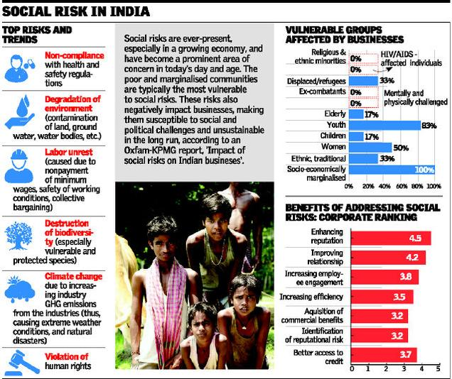
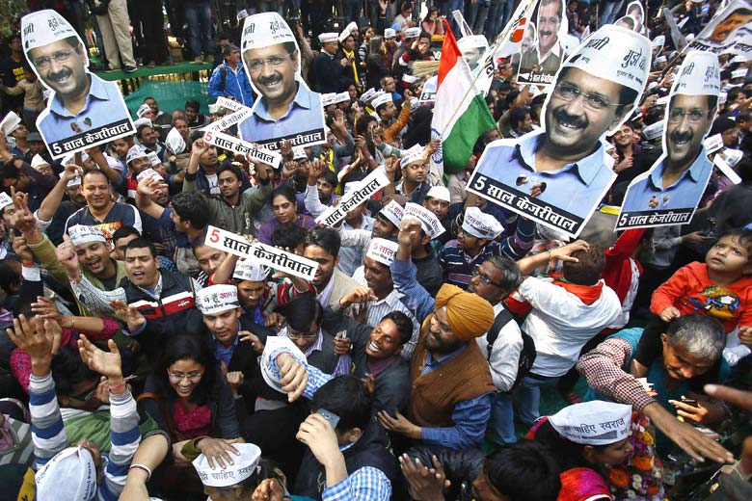
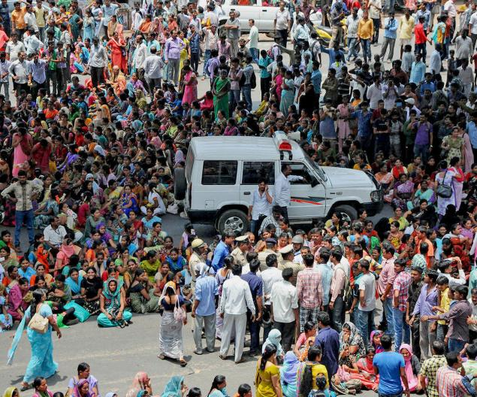
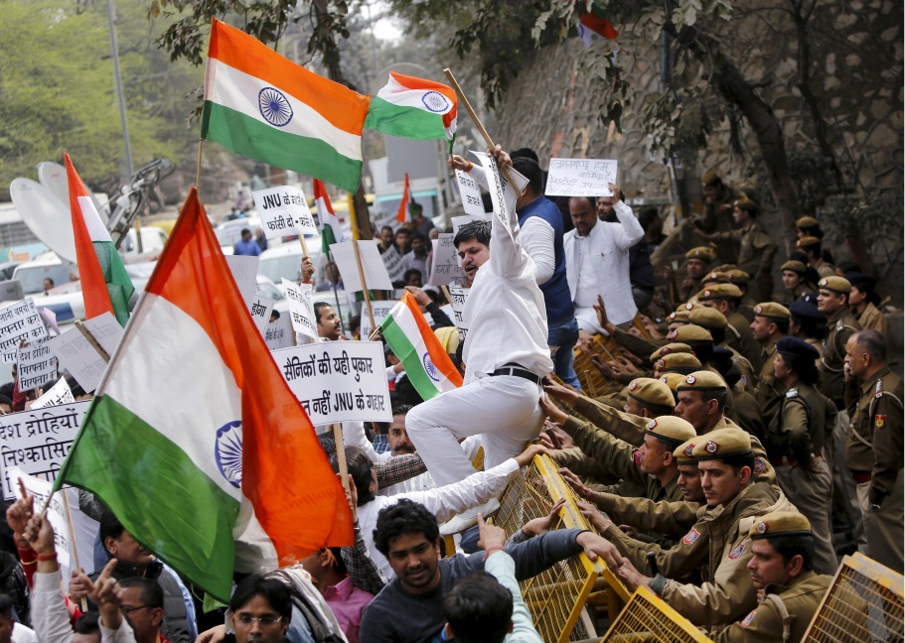

Changing societal expectations
Brewing discontent: “The garment workers have proved that there is a vast, angry India outside swanky offices.” The workers protest on Tumkur road in Bengaluru

Slide 12
Future of Reporting
1
Transparency will take the front seat. Internal and external communications will have to be effective
2
Personalized reports- sectoral reporting, region specific reporting etc. Report on demand for stakeholders. Static informational graphics transform into dynamic data visualization and brief statements turn into visual storytelling through videos and blogs.
3
Real time data access for stakeholders. Fully integrated performance.
Balanced reporting- focusing on both positive and negative - against short, medium, and long term targets demonstrating company’s commitment to driving this change.
4
Impacts of Parameters which shall aid in better decision making and integrates sustainability perspective. Monitoring impacts of activites while moving towards a low carbon economy.
5
Indicators which are in line with the broader development goals such as Sustainable Development Goals. What are organizations doing to align with the broader Sustainable Development Goals, how are they contributing to the economy, betterment of society and improving the environment.
6

Slide 13
Thank you
November, 2015
Santanu Roy
GAIL (India) Limited
General Manager (Corporate Planning)
sroy@gail.co.in

